Slide 1
Storage Devices We use everyday

Slide 2
Запоминающие устройства которые мы используем каждый день

Slide 3
What is SD?
A storage device is any computing hardware that is used for storing, porting and extracting data files and objects. It can hold and store information both temporarily and permanently, and can be internal or external to a computer, server or any similar computing device.

Slide 4
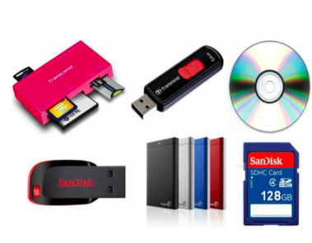

Slide 5
About!
A storage device refers to a computing hardware used to store information permanently or temporarily. The device can be external or internal to a computer, server, and other computing systems. Storage devices are also known as storage medias. There are two types of storage device: secondary storage device and primary storage device.

Slide 6
Primary storage device
A primary storage device is quite smaller in size and it’s designed to capture or hold data for a temporary period. Most primary storage devices are found inside the computer, and they have the fastest access to data. Examples of Primary devices include Cache memory and RAM.

Slide 7
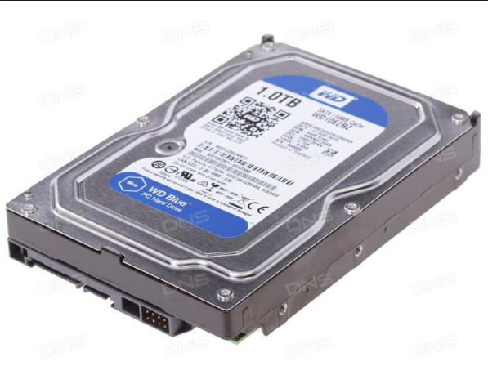

Slide 8
Secondary storage device
A secondary storage device has a larger storage capacity and can store data permanently. The device can be both external and internal to a computer and includes; compact disk, USB drive, hard disk, etc.

Slide 9
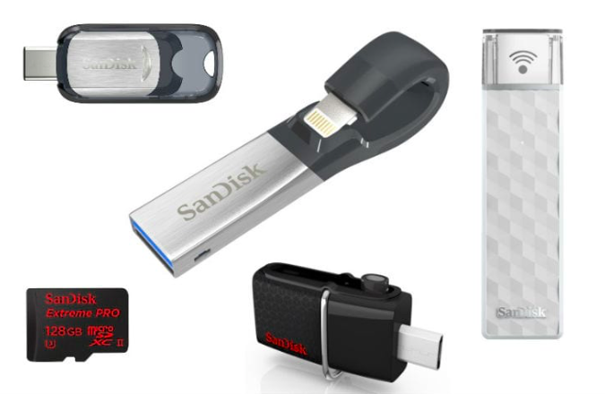

Slide 10
Hard disk drive, or HDD, hard disk, hard drive-random access storage device based on the principle of magnetic recording. It is the primary data storage in most computers.

Slide 11
DVD-optical media, made in the form of a disk, to store various information in digital form.

Slide 12
CD - ROM-optical media in the form of a plastic disk with a hole in the center, the process of recording and reading information which is carried out using a laser. Further development of the CD-ROM became a DVD and Blu-ray, and its closest "ancestor" — LD-ROM.

Slide 13
Magnetic tape is a data carrier in the form of a flexible tape covered with a thin magnetic layer. Information on the magnetic tape is recorded by magnetic recording. Devices for recording sound and video on magnetic tape are called respectively tape recorder and video recorder.
Flash memory is a kind of semiconductor technology of electrically reprogrammed memory. The same word is used in electronic circuitry to refer to technologically complete solutions of permanent storage devices in the form of chips based on this semiconductor technology

Slide 14
Common Problems encountered with Storage devices
Hardware failure. Hardware failure is one of the most problematic issues affecting most users. Appropriate handling and regular maintenance can be used to prolong the durability of storage devices.
Data Loss. Intentional and accidental file deletion can make one to lose precious data. Data recovery programs provide a solution for lost files, deleted data, corrupt documents and hidden files. In the event of a data loss scenario, a reliable data recovery software can be used to retrieve back 70% of the lost data.

Slide 15
Thank you.
Спасибо.

